Slide 1
Protest Classification
A Look at a cloud solution

Slide 2







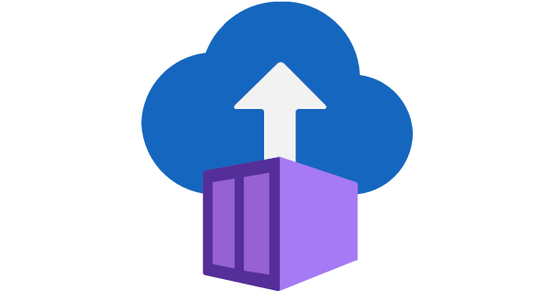
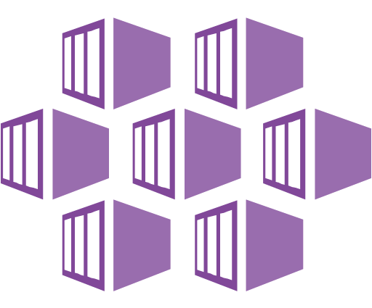
Architecture Proposal
Resource Group
Data Factory
Blob Storage
Machine Learning
Container Registry
Container Instance
Kubernetes Service
Pre-production
Production
Continuous Integration
Continuous Deployment
Data is prepared from news outlets and moved into data factory
Move data to blob storage
Access data from Blob storage in Machine Learning studio
Train and log Models and performance metrics as well as register the champion
Take registered champion and create an API via azure container instances
If ACI API is successful take registered champion and create an API via azure Kubernetes service

